Slide 1
Bird Strike Analysis
Lipsa Priyadarshini Barik

Slide 2
Introduction
A bird Strike can be defined as a collision between a bird species and the aircraft engine . A bird strike can result in various mishaps such as crash landing of aircraft or an aircraft getting stalled which may lead to some unavoidable circumstantial landing situations.
In order to prevent such mishaps from happening in the near future we propose an idea of predicting future bird strikes and analysis of the previous years data of bird strikes. The data of the previous years will be analyzed and will help in improving the accuracy of prediction of bird strikes that might occur over the period of next five years.
The prediction and analysis would be based on the parameters such as phase of flight, period of the day or altitude. Numerous other parameters like bird species and size of bird species can also be analyzed through which there can be a pattern established which will not only help us understand the birds’ migration route but also help prevent any bird strikes in future.

Slide 3
Preprocessing
The Bird Strike Dataset was imported into Python, ensuring seamless integration for analysis.
Null and missing values were meticulously examined, ensuring data integrity and accuracy.
Data imported to the Tableau.
Creating KPIs from the Dataset.

Slide 4
KPIs
Number of bird strikes: 20,142
Number of Stuck: 57,646
Average feet above ground: 795
Sum of people injured: 21

Slide 5
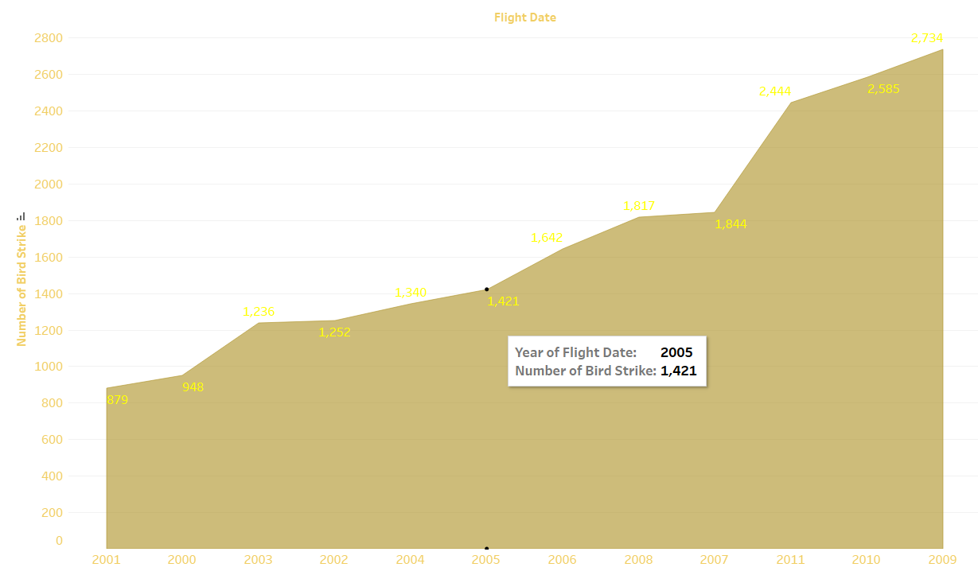
Yearly Wise Bird Strike
Here we can see that yearly wise Bird strike.

Slide 6
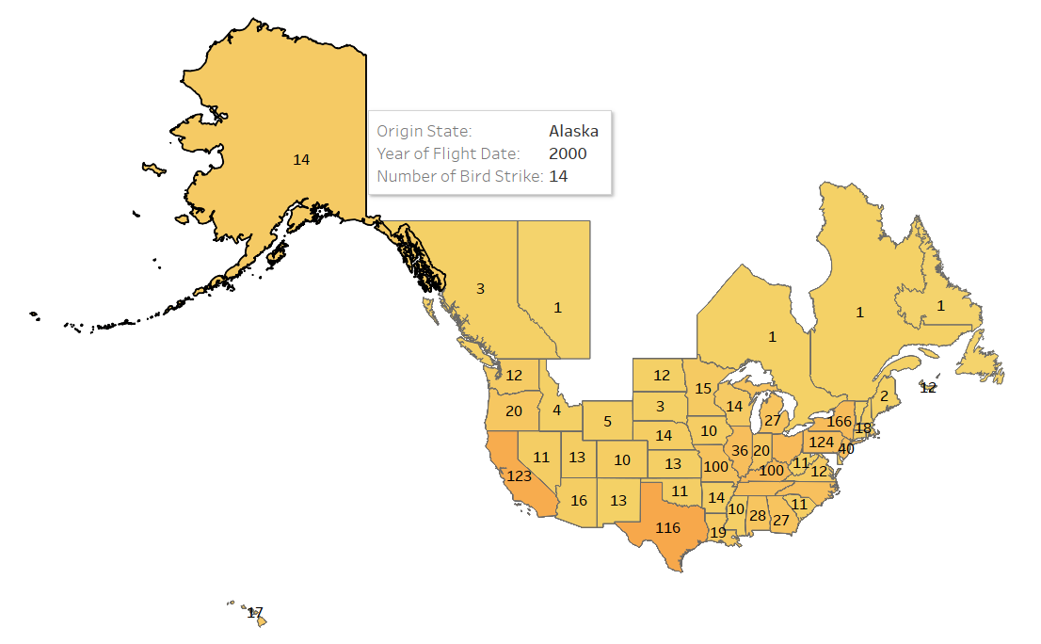
Yearly wise Bird Strike of US
Here we can see that yearly wise Bird strike in cities of US.

Slide 7
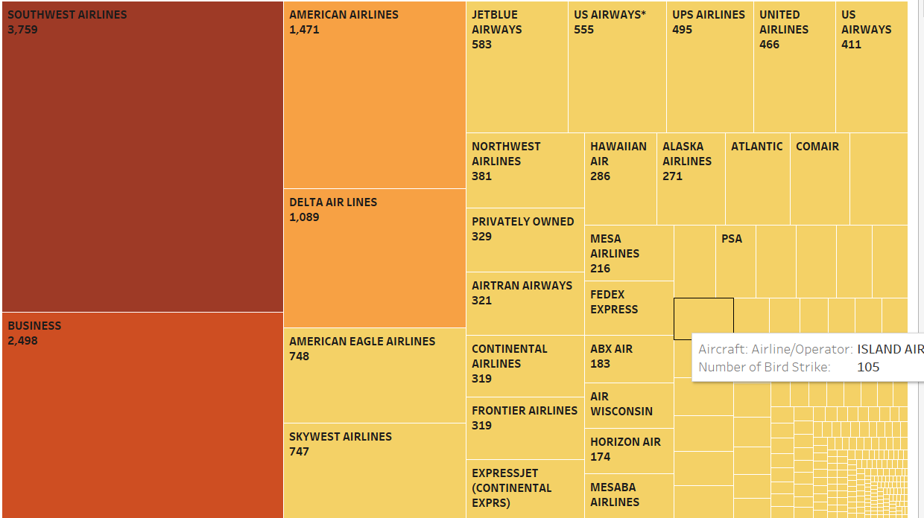
Bird Strike by Airlines
Here we can see that Bird strike by top Airlines.

Slide 8
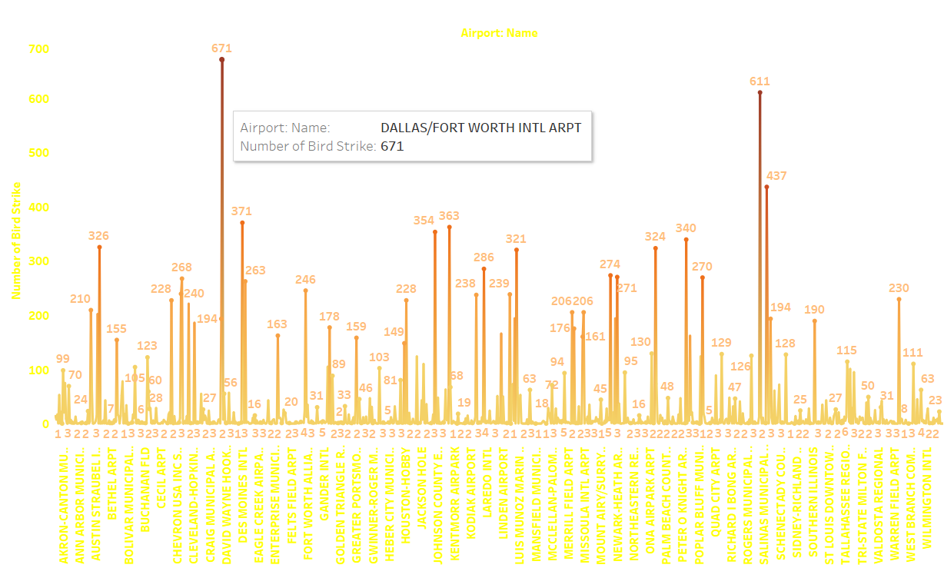
Airport wise Bird Strike
Here we can see that yearly which airport having high bird strike record.

Slide 9
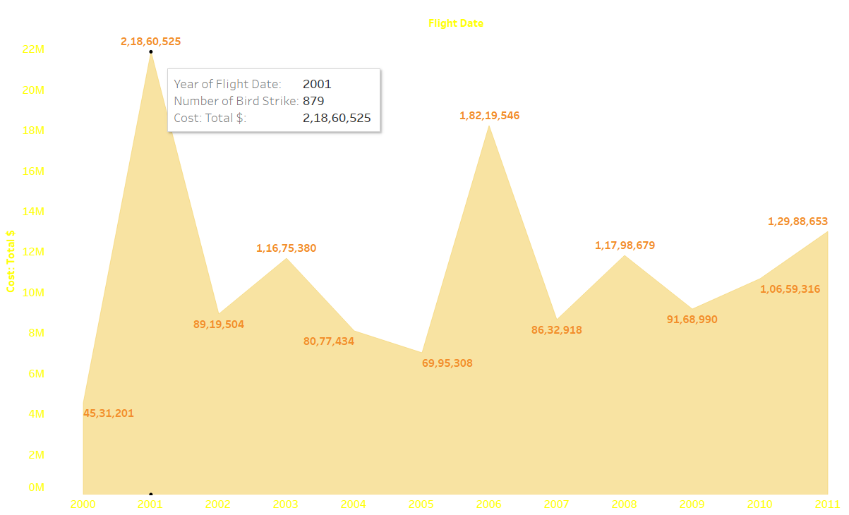
Yearly Wise Cost by Bird Strike
Here we can see that yearly wise cost expenses by Bird strike.

Slide 10
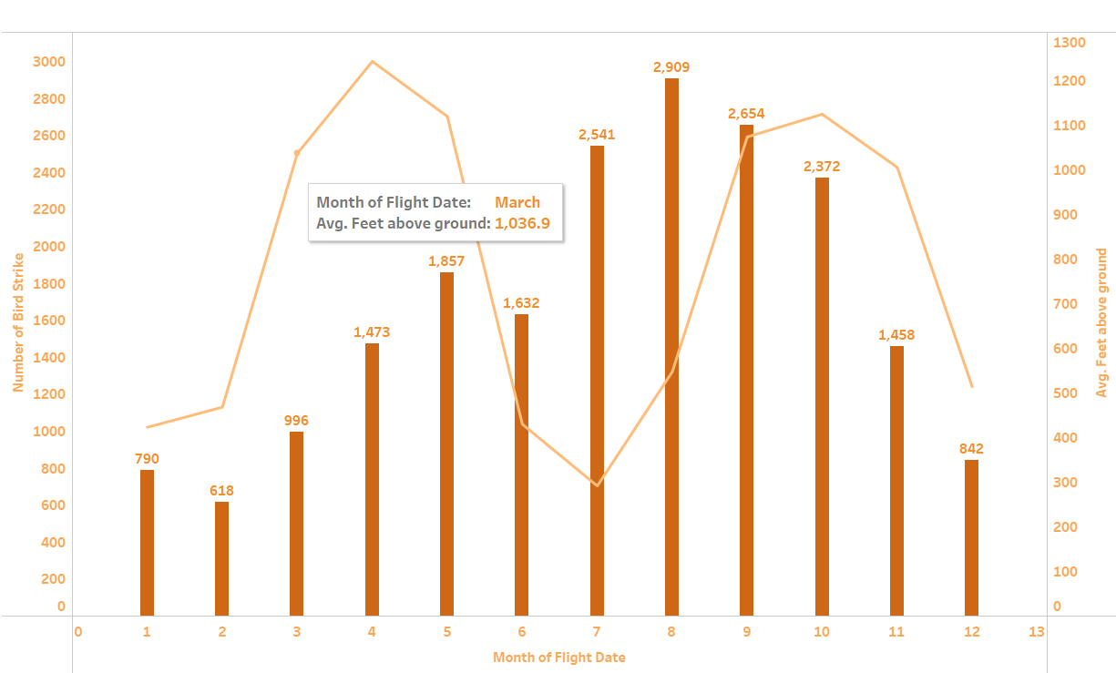
Monthly & Avg. feet Above the ground By Bird Strike
Here we can see that August has the highest bird strike i.e 2,909

Slide 11
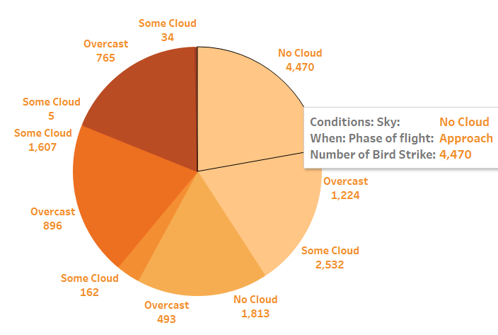
When are Bird strikes becoming more common?
Here we can see that with no cloud condition and in phase of approach, bird strikes happened more.

Slide 12
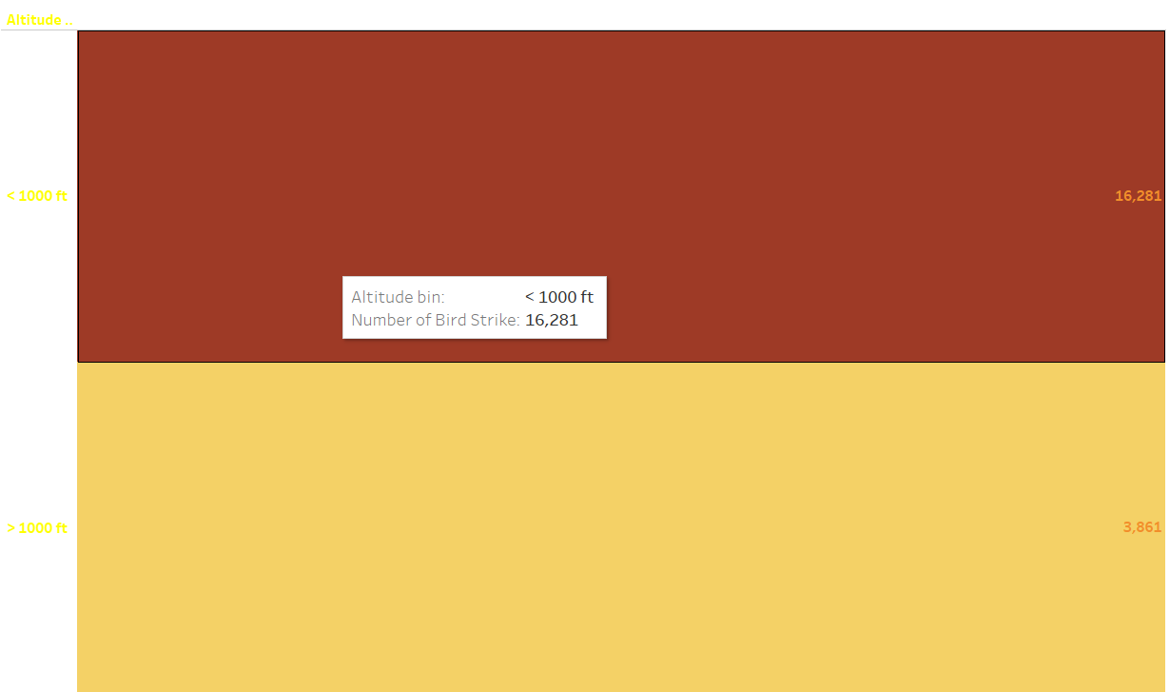
Altitude wise Bird Strikes
Here we can see that Altitude wise Bird strike.

Slide 13
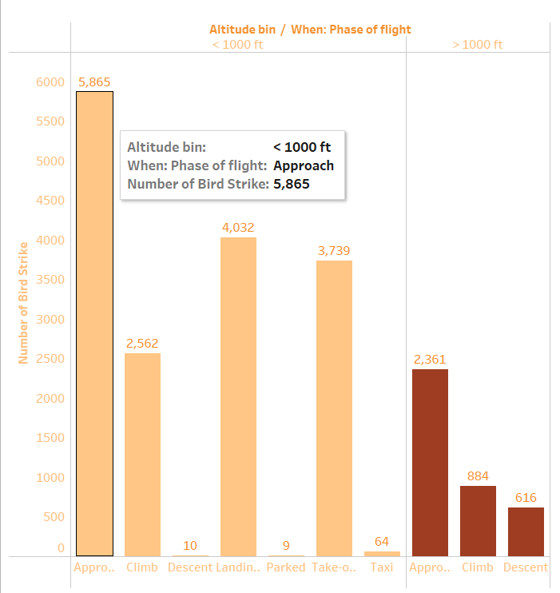
Altitude & Phase Wise Bird Strike
Here we can see that in approach phase & <1000 ft altitude, strikes rate is high

Slide 14
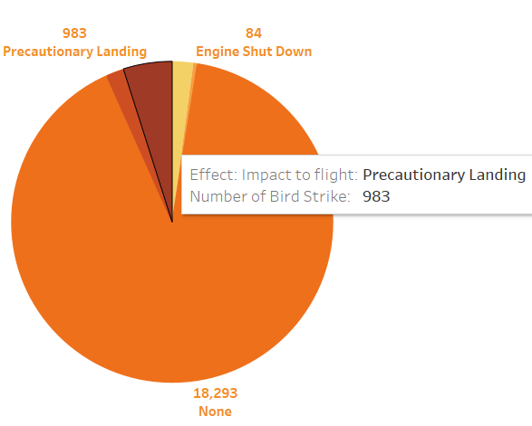
Impact to Flight for Bird strike
Here is the pie chart

Slide 15
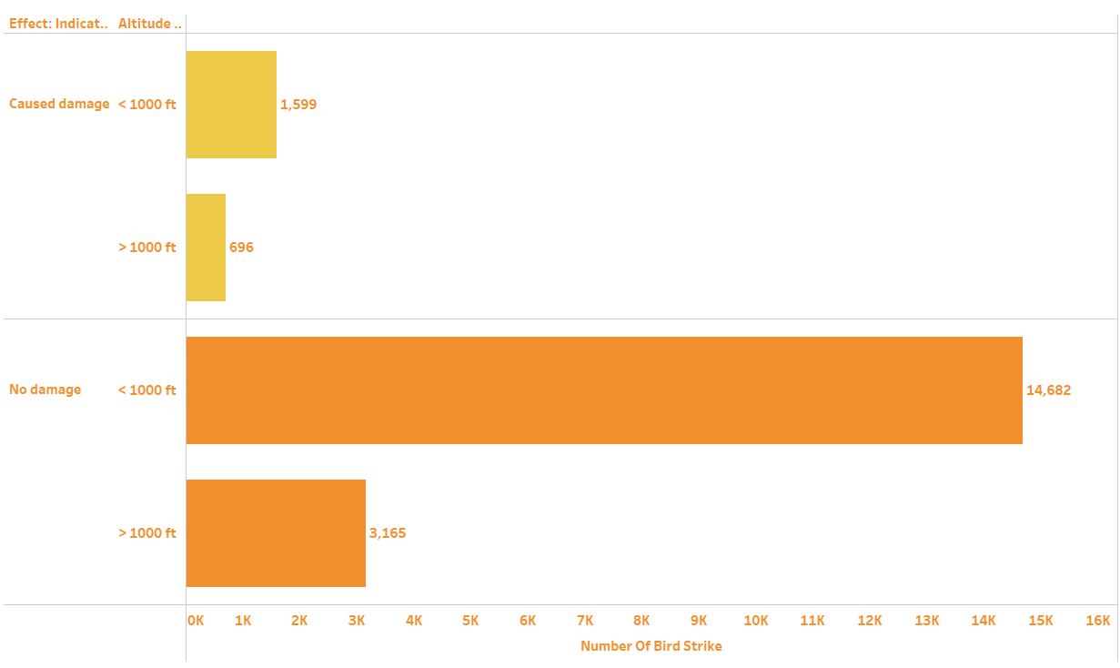
Effect of Bird Strike by altitude
Here we can see that at <1000 ft altitude bird strikes most but no damages.

Slide 16
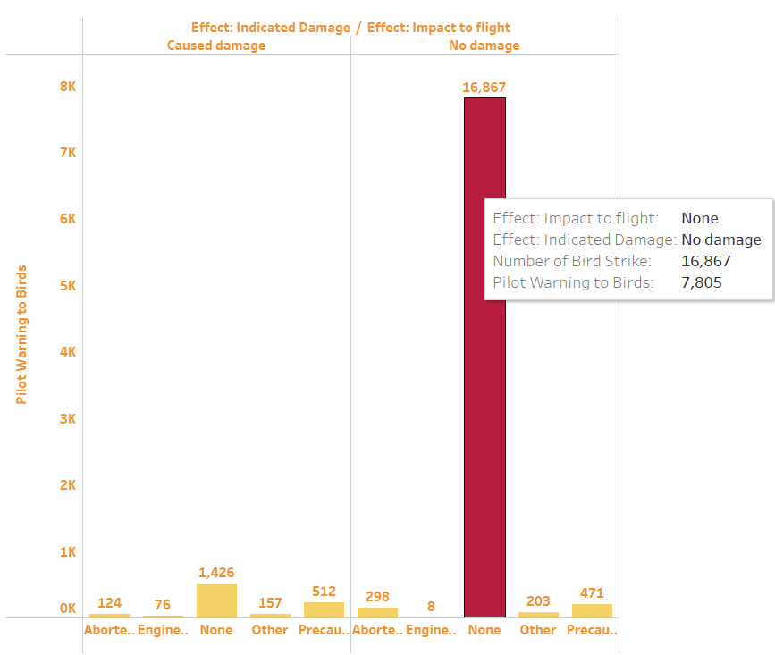
Pilot warning by Effect & Bird Strike
Here we can see that with the high warning rate more bird strike happens but causes no damage.

Slide 17
Conclusion
By making this project we have come across various aspects of KPIs and learnt how to apply them to real life situations and problems.
We can thus use this analytic Dashboard in an efficient way , thus contributing to the betterment of the environment and maintaining the balance of the ecosystem.
We can thus help the aviation industry to reduce the number of possible accidents by making such platforms where they can get the prediction of the accidents that may take place.
We can also help maintain the ecosystem by trying to reduce the number of accidents thus saving the species of birds and human lives.

Slide 18
Thank You

